Slide 1
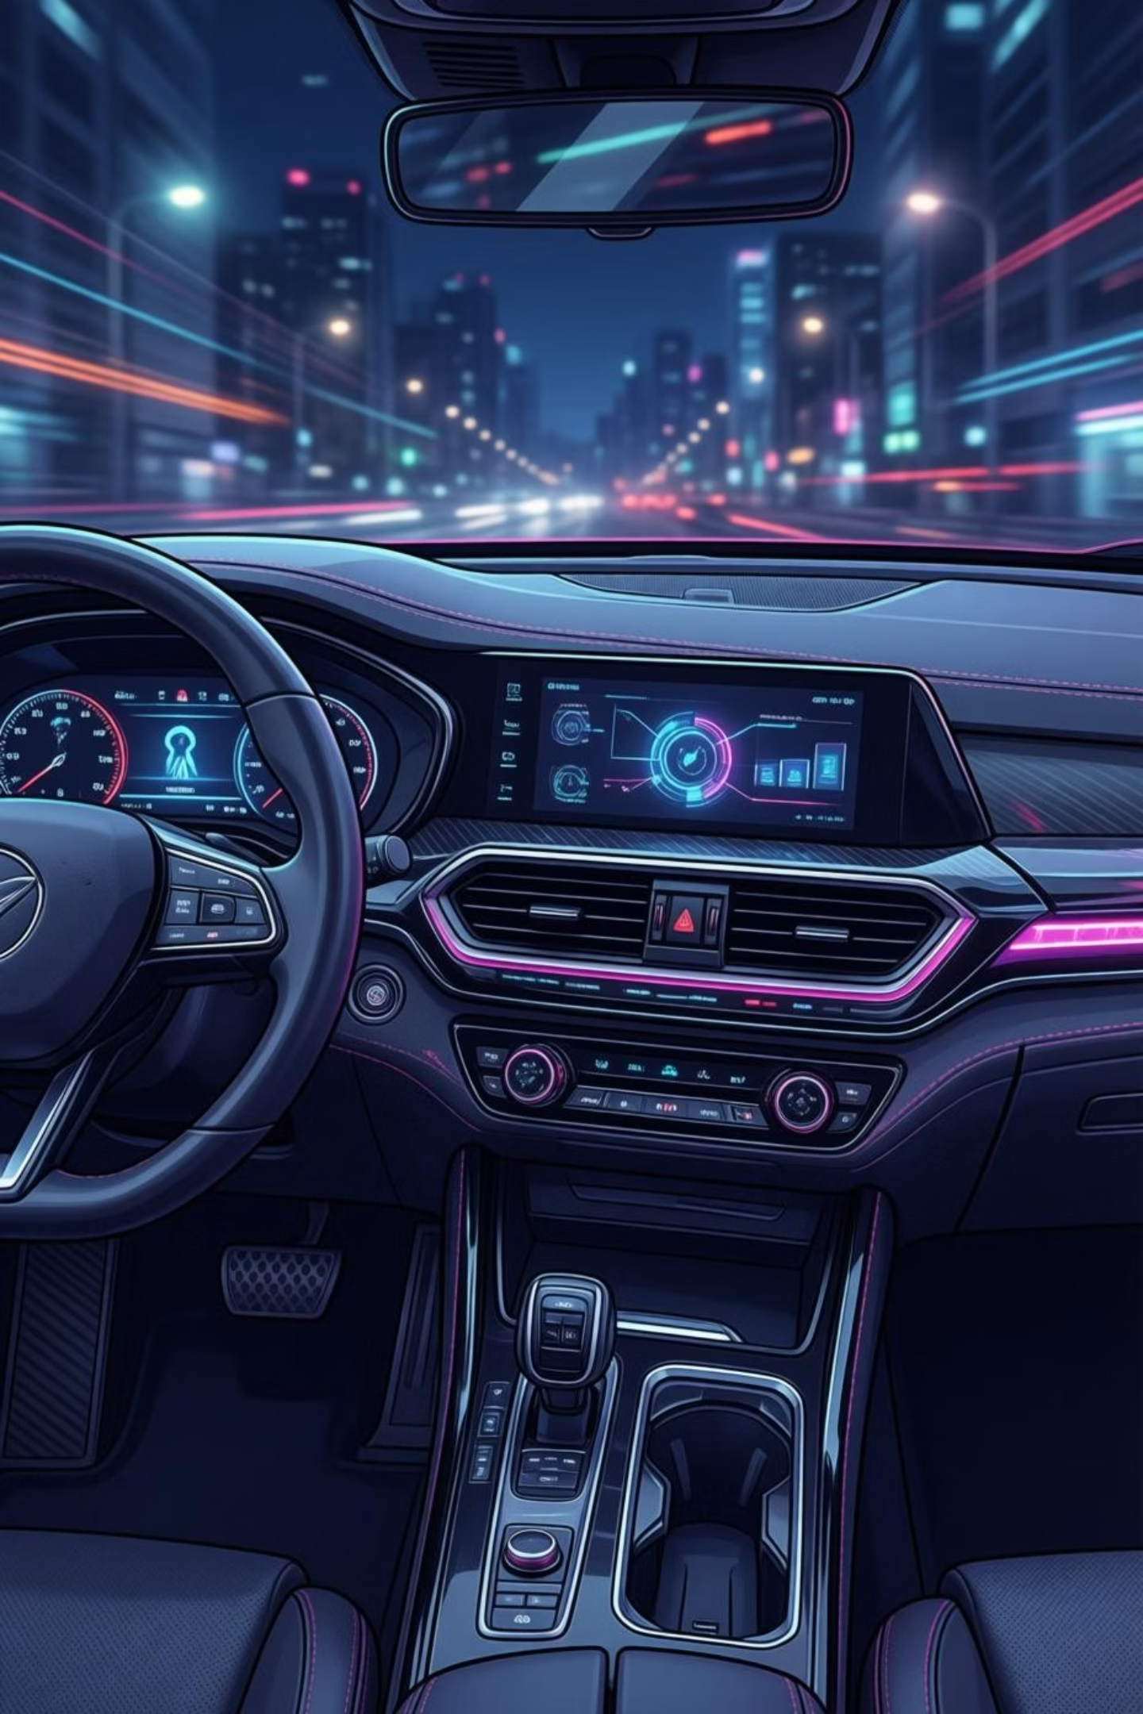
Driver Drowsiness and Speed Monitoring System
An Arduino-Based Embedded & IoT Safety System
Presented by: Fatima Faiz | Domain: Embedded Systems & IoT

Slide 2

SAFETY INNOVATION
The Critical Need for Driver Monitoring
Road accidents remain a leading cause of fatalities worldwide, with driver drowsiness and excessive speed being primary contributing factors.
Key challenges:
Prolonged driving diminishes alertness and reaction time
Manual monitoring proves unreliable and inconsistent
Lack of real-time intervention systems
Growing need for automated safety solutions

Slide 3
Problem Statement
Driver Fatigue
Over-Speeding Risk
Drivers may lose consciousness or experience microsleep episodes whilst operating vehicles, leading to catastrophic accidents.
Excessive vehicle speed dramatically increases both accident probability and severity of collisions.
Absence of Real-Time Alerts
Affordability Gap
Current systems lack immediate intervention capabilities to warn drivers before critical situations develop.
Commercial safety systems remain expensive, creating a need for accessible, low-cost alternatives for widespread adoption.

Slide 4


PROJECT GOALS
System Objectives
01
Real-Time Drowsiness Detection
Continuously monitor driver eye movements and detect signs of fatigue with immediate response capabilities.
02
Vehicle Speed Monitoring
Track vehicle velocity in real time and identify when speed exceeds safe thresholds.
03
Multi-Modal Alert System
Deploy audible alarms and physical stimulation (water spray) to effectively rouse drowsy drivers.
04
Dual Implementation
Develop both simulation-based prototypes and practical hardware implementations for comprehensive testing.

Slide 5





System Architecture Overview
Arduino Controller
Central processing unit coordinating all system operations
Sensor Network
Continuous monitoring of driver state and vehicle parameters
Alert Generation
Immediate response when unsafe conditions are identified
Manual Override
Emergency deactivation for driver control
The Arduino Uno serves as the intelligent heart of this embedded system, processing sensor data and triggering appropriate responses within milliseconds.
This architecture ensures reliable, fail-safe operation whilst maintaining simplicity and cost-effectiveness.

Slide 6




Hardware Components
Controller
Arduino Uno: Main microcontroller board with ATmega328P processor
Sensors
IR Eye Blink Sensor: Practical eye closure monitoring
Potentiometer/Hall Effect: Speed measurement
LDR Module: Ambient light detection for day/night mode
Output Devices
Buzzer: Audible alert generation
Relay Module + Water Pump: Physical stimulation system
RGB LED: Visual status indicators
16×2 LCD Display: Real-time information output

Slide 7



SIMULATION
Tinkercad Virtual Prototype
Simulation Configuration
Ultrasonic sensor emulates eye-blink detection through distance measurement
Potentiometer simulates variable vehicle speed input
LDR circuit determines operational mode based on lighting conditions
Serial Monitor enables debugging and parameter verification
Design Note: Virtual simulation was employed due to the limited availability of specialised sensors in Tinkercad's component library, whilst maintaining core functionality testing.

Slide 8

Practical Hardware Implementation
Sensor Integration
Alert Mechanisms
IR eye-blink sensor mounted on modified white spectacles for accurate detection
Relay-controlled water pump and buzzer system for immediate driver stimulation
1
2
3
4
Speed Measurement
Real-Time Response
Hall-effect sensor interfaced with wheel rotation for precise velocity calculation
RGB LED provides instant visual feedback with sub-second latency
The practical implementation delivers significantly enhanced accuracy compared to simulation, with real-world sensor data providing reliable detection under various environmental conditions.

Slide 9





SYSTEM OPERATION
Working Principle
Data Acquisition
Multiple sensors continuously collect real-time data on driver state and vehicle parameters at high frequency.
Signal Processing
Arduino processes incoming sensor inputs, filtering noise and applying detection algorithms.
Condition Analysis
System evaluates data against safety thresholds to identify drowsiness or excessive speed conditions.
Alert Activation
Upon detecting unsafe conditions, appropriate warning mechanisms are immediately triggered.
Manual Override
Driver can deactivate alerts using dedicated OFF button, providing ultimate control and safety.

Slide 10

Drowsiness Detection Algorithm
Eye Closure Detection
1
IR sensor identifies when eyelid blocks infrared reflection
Duration Monitoring
2
System tracks closure duration against preset threshold
Drowsiness Classification
3
Extended closure beyond threshold triggers drowsy state
Alert Deployment
4
Buzzer activates and water pump engages to rouse driver
"The system employs a time-based algorithm ensuring that brief, natural blinks don't trigger false alarms, whilst extended eye closure immediately activates safety protocols."

